Slide 1
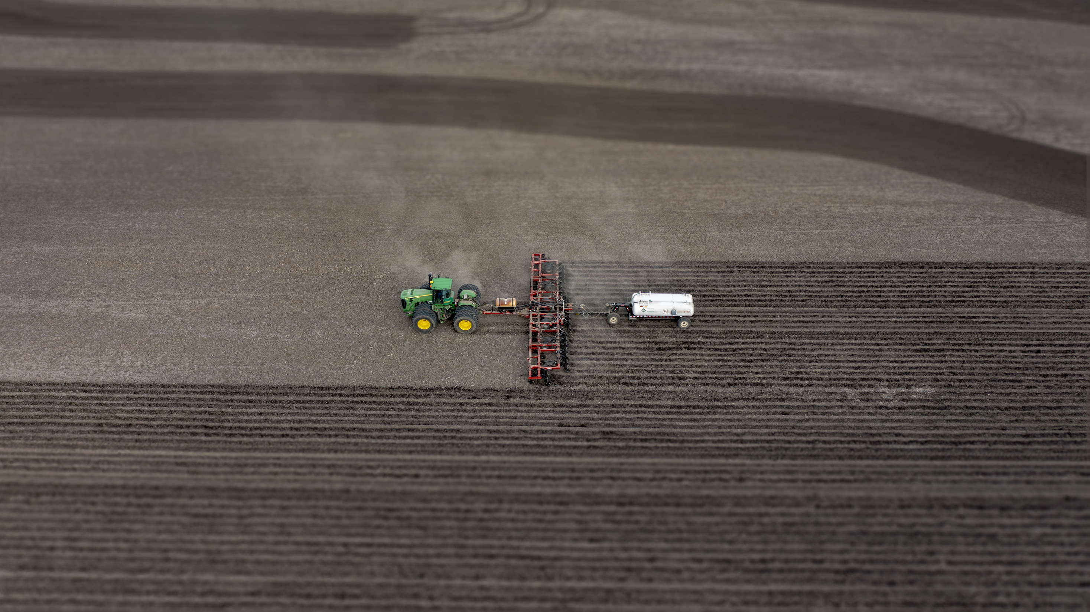


Getting Fall Fertilizer Right
Illinois Fertilizer & Chemical Association Webinar, October 26, 2021
Emerson Nafziger
Crop Sciences

Slide 2
First topic: P and K
High P and K fertilizer prices and possible supply issues bring questions about applying P/K this fall or waiting until- next spring? next fall? longer than a year?
Current approximate prices (subject to change):
MAP (11-52-0): $885/t = $0.85/lb P₂O₅
DAP (18-46-0): $815/t = $0.89/lb P₂O₅
Potash (0-0-60): $775/t = $0.65/lb K₂O

Slide 3
P and K – Crop Removal
Crop removal numbers based on a recent survey in Illinois; 75% of samples collected were less than these values:
Corn: 0.37 lb P₂O₅, 0.24 lb K₂O per bushel
Soybeans: 0.75 lb P₂O₅, 1.17 lb K₂O per bushel
200 bushels of corn remove 74 lb P₂O₅ and 48 lb K₂O
65 bushels of soybean remove 49 lb P₂O₅ and 76 lb K₂O
Together, that’s 123 lb P₂O₅ and 124 lb K₂O
To replace using DAP for P, that would total $190/acre (covering two years): replacement: corn $97; soybean $93

Slide 4
P and K: Delay or Not?
If soil test levels in medium– to heavy-textured soils currently exceed 25-30 ppm for P and 150-175 ppm for K, applying none for the 2022 crop carries little risk of yield loss
  One caution: root-restricting conditions (no-till, dry soils) next season may result in K deficiency symptoms even if ST levels are adequate
The main issue: P and K removed by crops will need to be replaced eventually (maybe not fully if ST levels are high), and future supplies and prices are uncertain

Slide 5
P and K: Placement
Subsurface application (deep-banding) of P is being promoted
  Most research has not shown a yield advantage to doing this
  It does help decrease runoff of P (and N) on sloping soils
  It also disturbs the soil, and may increase soil erosion
  It’s more costly and time-consuming than broadcast
All considered, broadcasting P & K in the fall or spring is fast, inexpensive, and effective in most fields
Planter-applied P & K help provide nutrient early
  But this seldom boosts yield if ST levels are adequate
  Planter-applied (liquid) forms are more expensive per lb of nutrient

Slide 6
P and K: Timing
Fall broadcast application is usually OK, but:
  Loss of P from slopes is possible if it rains a lot after application
  Nitrification of N from of MAP/DAP is more likely with fall earlier application on warm soils; loss is possible
Spring broadcast application also works well:
  More of the N from MAP/DAP is likely to remain for the crop
  Runoff may be less likely, and unlikely if tilled after application
  Logistics may be an issue, especially if the spring is wet
  Application after planting? Complicated: surface pH, ST levels, tillage
Planter-applied P & K provide nutrients to plants early
  But this seldom boosts yield if ST levels are adequate
  Planter-applied (liquid) forms are more expensive per lb of nutrient

Slide 7
Nitrogen: Maximum Return To Nitrogen (MRTN)
Nitrogen prices and availability are challenges for the 2022 corn crop:
The current price of natural gas (primary feedstock for NH₃ production) is about twice what it was a year ago
“Supply chain issues” are making prices and availability more uncertain than usual
The corn price for 2022 is currently projected at $5.00 per bushel, down from ~$5.25 for all of 2021

Slide 8
How “imperfect” is the MRTN?
16 Soy-Corn Trials, Central IL, 2020
We can assess any set of response data against the predicted MRTN from previous trials
The MRTN based only on only these 16 sites is about 23 lb higher than the prior MRTN
Adding these data into the MRTN database increased the (2021) MRTN slightly
What will adding 2021 data do?
The MRTN “overweights” responses to high rates of N where yields start out low.
It is NOT the “average EONR” across trials

Slide 9
35 on-farm trials
Soy-Corn 2015
Wet June
High N rates needed
33 on-farm N trials
Soy-Corn 2016
Dry Spring
Low N rates needed

Slide 10
Why is (fertilizer) N rate so “difficult”?
Tough to predict yield/N need AND soil N supply
Producing 1 bu of grain requires ~1 lb of N
²/₃ of the N is in the grain at maturity
Averaged across trials:
~½ crop’s N requirement
comes from the soil
Ranges from <5% to >90%
274 trials
Central Illinois

Slide 11
More about the MRTN
No two N rate trials are exactly alike, so having the MRTN based on data from previous trials means that it can’t give a perfect prediction for a given field in a given year:
It is, though, the BEST GUESS we have
Finding best N rates is not a “contest”: N responses are not predictable, and we either use results over a lot of trials or we make it up (e.g., “just use plenty of N”)

Slide 12
A first look at some N rate responses in 2021

Slide 13
N rate response in 2021 – 10th in a series from 1 producer

Slide 14
N rate response in 2021 – 8th in a series with 1 producer

Slide 15
N rate responses in 2021 – 14.8 inches of rain in May-June

Slide 16
N rate responses in 2021 – southern Illinois

Slide 17
N rate responses in 2021
2021 summary to date:
Somewhat typical N responses, as years go
Some high yields with no/low N rates
Response to higher N rates where wet in May & June (W-WC IL)
Adding in the 2021 data is unlikely to move MRTN values very much

Slide 18
Changing MRTN with changing prices, 2022
Corn at $5.00; N price as indicated
IL Region | Rotation | MRTN at N price, $ per ton NH₃/$ per lb N
 |  | $600/0.37 | $800/0.49 | $1,000/0.61 | $1,200/0.73
North | Soy-Corn | 185 | 172 | 161 | 153
 | Corn-Corn | 222 | 206 | 197 | 185
Central | Soy-Corn | 193 | 182 | 173 | 166
 | Corn-Corn | 212 | 200 | 193 | 183
South | Soy-Corn | 214 | 200 | 194 | 184
(Spring) | Corn-Corn | 215 | 198 | 188 | 179

Slide 19
Change in Illinois MRTN, 2015 to 2021
South
Central
North
Adding N trials by IFCA and UI (and dropping older data)
have changed MRTN values

Slide 20
Fall v. Spring-applied NH₃: 17 on-farm comparisons (w N-Serve in fall)
Summary:
Yields at the optimum N rate were identical: 237.7 bu/acre for fall-applied and 237.8 bu/acre for spring-applied N
The optimum N rate was 211 lb/acre for fall-applied and 194 lb/acre for spring-applied N
The difference (17 lb N) is in the vicinity of what has been found in tile-drainage comparisons: more loss from fall- than spring-applied

Slide 21
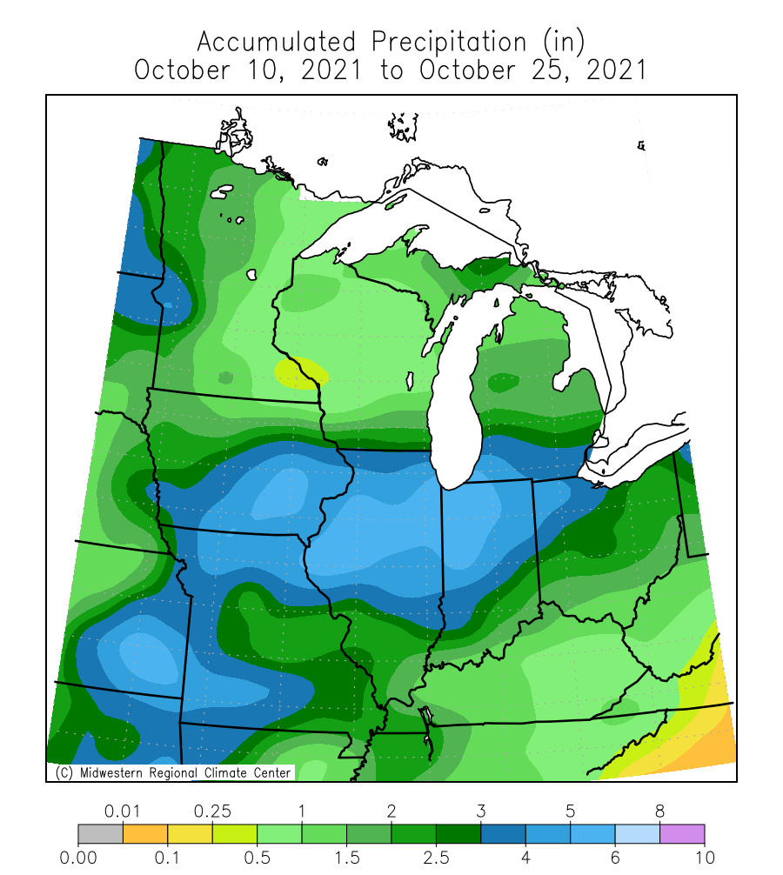
N application in Fall 2021
There is NH₃ available, but consistency of supply as application gets underway is not known
NH₃ prices continue to rise, which should decrease rates some
October rainfall is exceeding average amounts, which may discourage application, although a dry November could reverse that
Soil temperatures remain slightly high for safe application now, but OK in N IL (may be OK in C IL) once it dries out

Slide 22
Illinois soil temperatures, October 2021
Data are from the Illinois Climate Network, WARM program: https://www.isws.illinois.edu/warm/soil/
Chose 4” depth at 10 AM:
  Should not be max
  Should not be min
  Avg of max/min not is not reliable
Average of 4 sites in northern IL and 5 sites in central IL

Slide 23
Is soil temperature really that critical?
Yes: conversion of NH₄⁺ to NO₃─ makes leaching and denitrification possible; as a biological process, rate depends on temperature
Figure shows that nitrification is still happening at 50 °F (it doesn’t stop until 32 °F) and it accelerates at temps>50
The more nitrification, the more N will be lost once tiles begin to run
Nitrification inhibitors help some, but they break down faster at higher temps as well

Slide 24
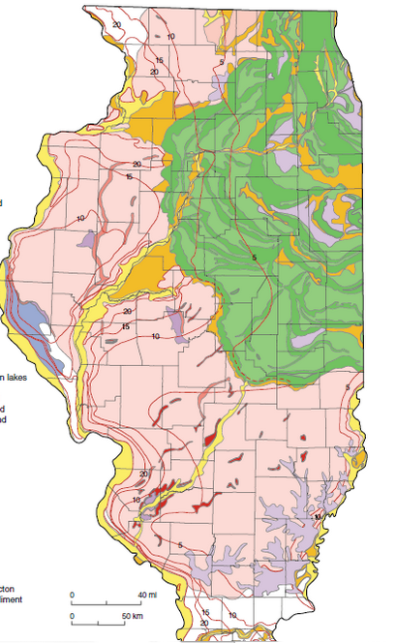
Basics: apply where it’s safer to apply
Map shows approximate line between safe application (north) and not-very-safe application (south). Prairie soils near the line may be safe
Waiting until December or January in southern IL would help at the start, but springs are warmer and wetter, and the risk of loss is much higher
North of the line, sandy soils, soils with gravel underneath, and chronically wet soils are not safe for fall application
When we pay more for N, we lose more $$s when N is lost

Slide 25
Bottom line(s) on fall NH₃ application
Will need to wait for dryer conditions in most fields: mudding in NH₃ in the fall is not advised
Soil temperatures need to get to 50° and be headed down at the time of application to keep most of the N in ammonium form through early spring
Use a nitrification inhibitor
If things do not come together to get NH₃ applied this fall, applying next spring remains a viable option, but may mean more uncertainty in N supply and price

Slide 26
Should we consider partial N rates this fall?
Applying half or so of the full rate in the fall is a way to limit potential for loss, but carries extra costs (application, labeled rates of nitrification inhibitor)
It might be a reasonable option (if done properly) if there’s supply this fall but not for sure (time, amount, or form) next spring
It does more or less commit the field to grow corn for next spring

Slide 27
What’s next for improving N rate predictions?
Fewer full-rate trials, many smaller trials more easily (and cheaply) done by producers, to produce data that will BUILD CONFIDENCE in the MRTN:
  Only two rates, including the one used in a field plus one lower or higher,
  chosen to form two rates (one in the MRTN range; one 50-60 lb higher)
  Plots 1/2 to 1 acre in size to allow use of normal equipment; sensing (aircraft, drone, etc.) during the season; YM yields from each rate on each side of each plot
  On different soils within and across (many) fields
Sensing & yield monitor data along with weather and soil information can be used to “train” an N prediction model that would improve on the current one
Dan Schaefer at IFCA [dan@ifca.com] will lead the field phase, with cooperation from the Precision Conservation Management program, retailers, and others

Slide 28
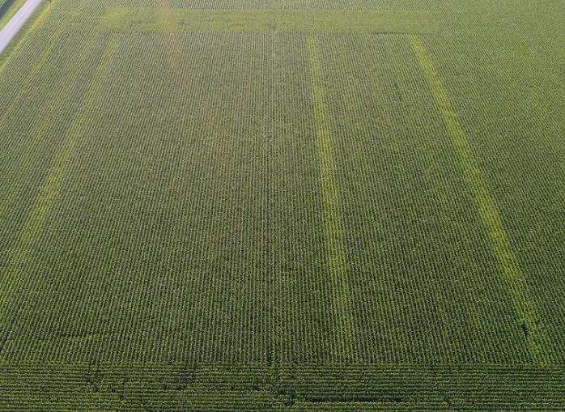
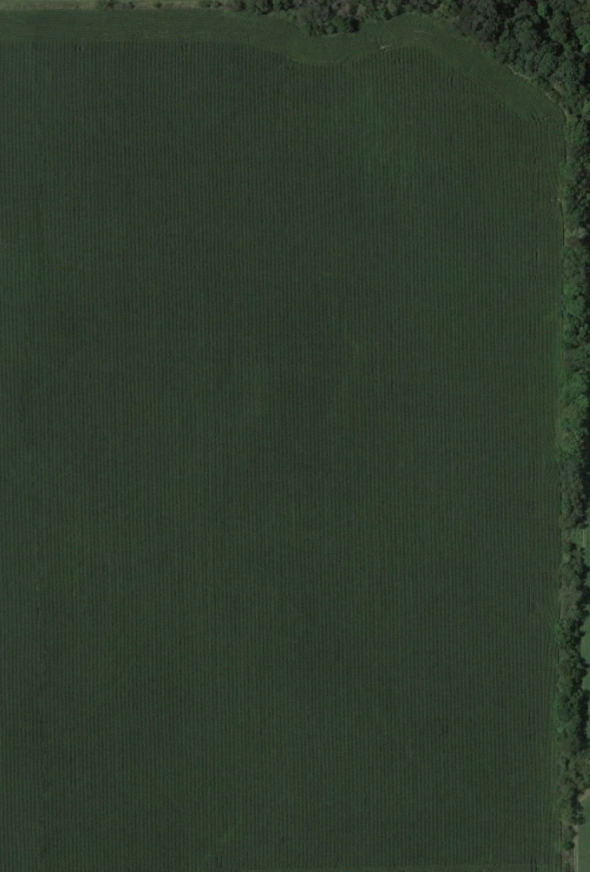

Instead of this (in 30-40 IL fields)
185 lb N: whole field rate
Y1 Y2 Y3 Y4
240
240
Something like this:
In lots of fields
240

Slide 29


Thank you
Questions?
Emerson Nafziger
ednaf@illinois.edu
Dan Schaefer
dan@IFCA.com

